Slide 1
Cinema Savvy
One stop shop for your movie needs

Slide 2

Project Description
Cinema Savvy provides the user with pertinent information related to their movie search all in one place.
Simply enter in a movie title and you can view the movie poster, rating, runtime, IMDB rating, plot, trailer and similar movies all in one simple search.

Slide 3
Motivation
Lack of simple view searches.
Well known movie sites are crowded with advertisements, cross-promotions and extraneous information, leaving the user to have search multiple sites to get all relevant information.

Slide 4
Result
By using Materialize, multiple APIS and YouTube we created an application that provides users all information pertaining to a certain movie in a organized, user friendly format.

Slide 5
Team Efforts
Victor was in charge of creating the initial design (mock up) and managing the GitHub versioning system.
Timber was responsible for organizing and styling the frontend, including basic html, CSS styling and mobile compatibility.
Janel was responsible for coding the backend that communicated with the APIs.
Testing was done as a group and all changes discussed by all team members.

Slide 6
Timber Responsibilities
Development of “front-end” part of the project
Creation and Optimization of UI
Making “Cinema Savvy” Mobile Responsive
Styling
Created a model to display trailers retrieved from YouTube

Slide 7
Victor Responsibilities
Creation of GitHub Development and Master environments
Management of Pull requests and commits via Gitkraken
Testing and final publishing of the Master branch to the final URL location
Participated in the testing of the final application
Tasked with SASS implementation (Materialize was adopted in the end)

Slide 8
Janel Responsibilities
Created a function that uses multiple ajax calls to call New York Times, OMDB and TMDB APIs
New York Times API – Retrieves critics review for movie searched.
OMDB API – retrieves poster, title, IMDB score, rating, runtime, genre and plot. This populates a table.
TMDB API – The API uses the movie entered to retrieve movie id, the second part of the API uses the movie ID to retrieve similar movies.
Embedded YouTube player to retrieve trailer for movie searched.
Added Functionality to allow users to click on the similar posters and this would repopulate the page with the similar movies.
Added error handling to account for missing/null information returned from API calls.

Slide 9
Challenges
Unavailability of Fandango API
Implementing Server-Side Authentication for Twitter API
Inability to find a way to add SASS into the development process

Slide 10
Improvements
Use movie APIs that can provide theater locations based off the entered movie.
Use jVectorMap to provide interactive map of theater location.
Embed Twitter API to show current relevant tweets related to movie search.
Use Firebase to store all searches and provide the user with a table that shows all movies that have been searched sorted by frequency.

Slide 11
Lessons Learned
Research all features and components thoroughly prior to committing to a design – this can result in rework.
When using additional libraries/technologies, ensure that they are fully compatible prior to implementation.
Final design will morph as you progress, dream realistically.
When estimating time , always allow for more.
Versioning is important, it needs to be well understood before making critical changes.

Slide 12
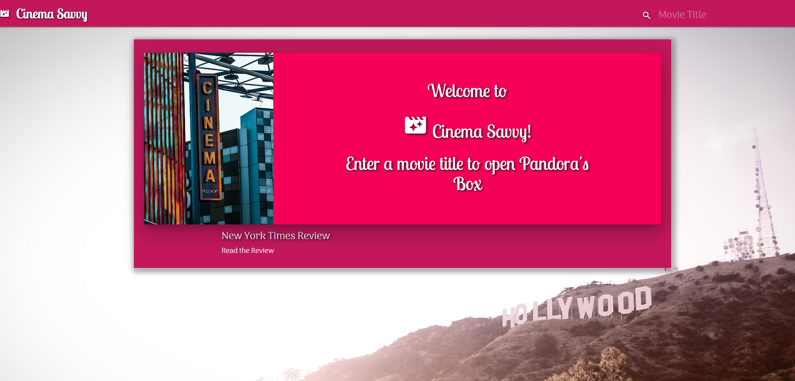
Demo

